Slide 1
Heart Disease
Finding the best classification model to predict heart disease

Slide 2
Project Design
The main question to answer is whether a model can accurately predict if a person has heart disease or not, based on the attributes of the data.
The objective is to create the best model by increasing accuracy, in the hold out test sample and increasing the AUC -- Area under the ROC curve.
The recall and precision will also be calculated to make sure the model isn’t predicting a lot of false positives.
The data will first be run on baseline models and then a few of them will be chosen to be tuned.

Slide 3

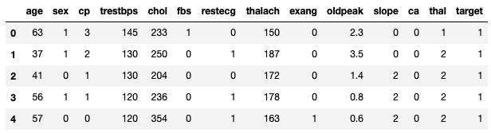
Dataset
https://archive.ics.uci.edu/ml/datasets/heart+Disease
This database contains 76 attributes, but all published experiments refer to using a subset of 14 of them. The “target" field refers to the presence of heart disease in the patient.

Slide 4

Data attributes
age
sex
chest pain
resting blood pressure
cholesterol
fasting blood sugar
resting electrocardiographic
maximum heart rate
exercised induced angina
depression induced by exercise
slope of the peak exercise
major blood vessels
thallium stress test
target

Slide 5
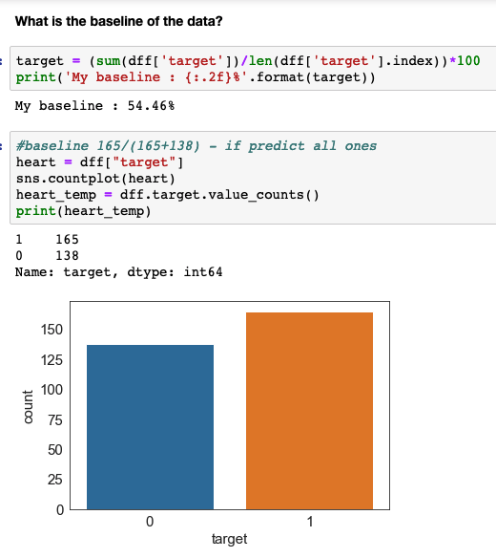
54.46% of the people in the dataset have heart disease.

Slide 6
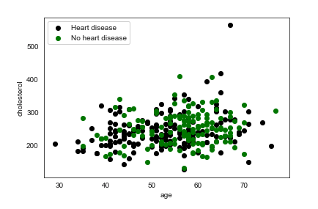
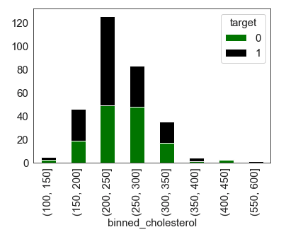
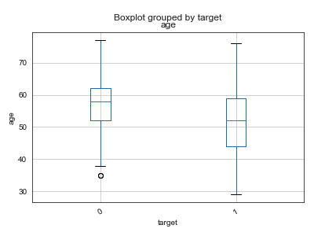
Age and Cholesterol
The average age for heart disease is lower than those who don’t have the disease.
Outliers are minimal.
Cholesterol between 200 and 250 have the highest amount of heart disease patients.

Slide 7
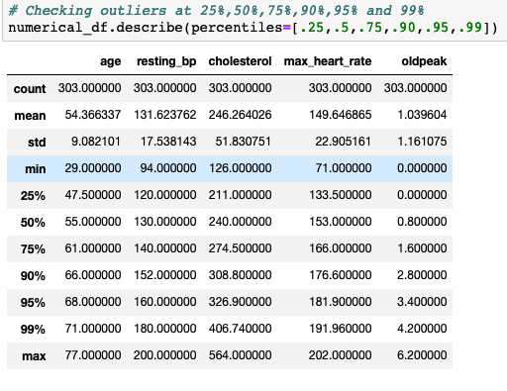
Description of the data
From the distribution shown:
a few outliners
no null values

Slide 8
Summary of the data
Variables are not correlated
There were no null values
Data was scaled due to the different parameters
The target variable was balanced
80% of the data was used for the training the model
20% of the data was used for testing the model

Slide 9
The objective is to create the best model by increasing the accuracy in the hold out data and increase the area under the curve.
A classification model will be used to determine which class a patient belongs.
First we will fit and test the data to base models, with out tuning parameters.
We will check the scoring of each algorithm to see which has the best fit.
We will then tune a few of the models.
From the tuned models, the best model will be boosted it to see if the score increase.

Slide 10
Base Models
Naive Bayes
KNN Classifier
Logistic Regression
Support Vector Machine
Random Forest
XGBoost

Slide 11
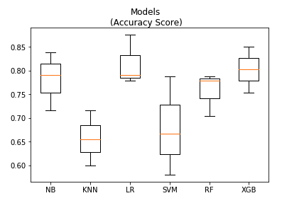
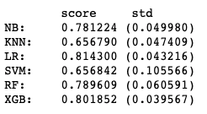
Model Baseline Scores
Logistic Regression has the best score
XGB has the best stability

Slide 12
Model Tuning
Four models were tuned to see if the score would change for the better. Grid-search was used to find the best combination of parameters which yielded the best accuracy score.
KNN Classifier
Random Forest
Support Vector Machines
Extreme Gradient boosting

Slide 13
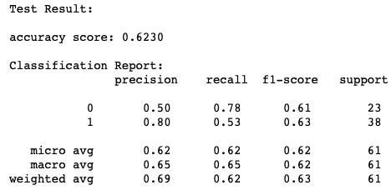
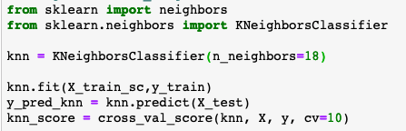
KNN tuning: n_neighbors
Comparing the baseline to the tuned model:
baseline score: 66%
tuned score: 69%
tuning helped 3% increase

Slide 14
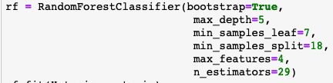
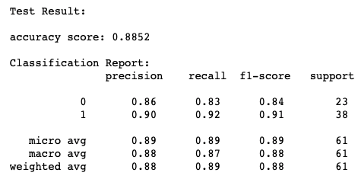
Random Forest tuning:
max depth
minimum samples leaf
minimun samples split
n_estimators
max features
Comparing the baseline to the tuned model:
baseline score: 78.96%
tuned score: 88.52%
tuning helped 9.56% increase

Slide 15

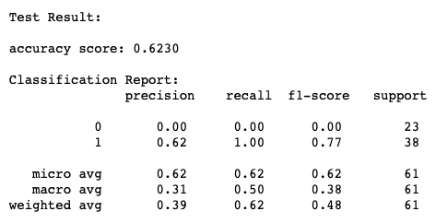
Support Vector Machines tuning:
gamma
C
Comparing the baseline to the tuned model:
baseline score 76.76% & std 0.088
tuned score 62.30%
tuning didn’t 14.46% decrease

Slide 16
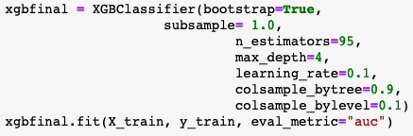
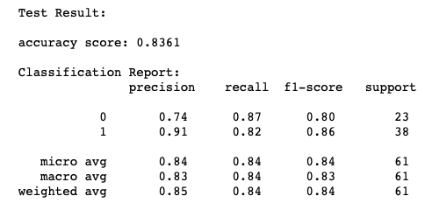
Extreme Gradient boosting tuning:
max depth
learning rate
column sample by tree
column sample by level
n_estimators
subsample
Comparing the baseline to the tuned model:
baseline score 80.19%
tuned score 83.61%
increased 3.42%

Slide 17
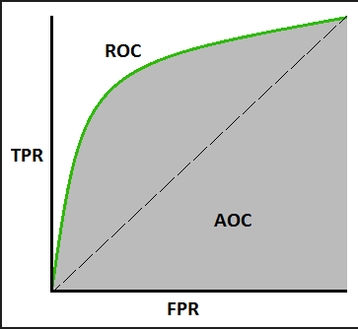
Model Comparison:
The metrics used to evaluate the models are the accuracy score and ROC/AUC.
AUC is the area under the ROC Curve . ROC Curve (receiver operating characteristic) shows the performance of the classification model at all classification thresholds.
True Positive Rate = TP/(TP+FN)
False Positive Rate = FP/(FP+TN)
Our goal is to not tell a person they have heart disease when they don’t and that they don’t have heart disease when they actually have it. So we need these scores to be low.

Slide 18
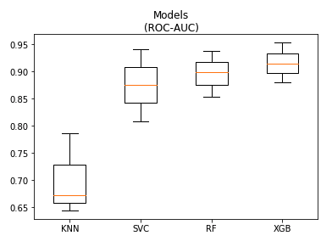
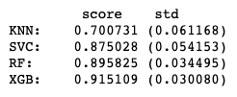
ROC/AUC Model Comparison
All the tuned models were put into a new jupyter notebook and compared side by side.
XGB has the best score
XGB is the most stable

Slide 19
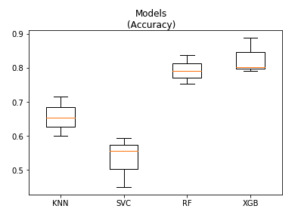
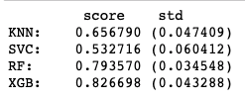
Accuracy Score Model Comparison
XGB has the best score
RF the most stable

Slide 20
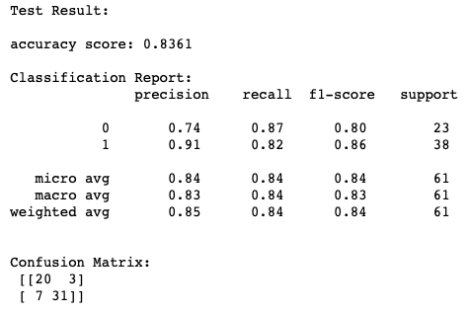
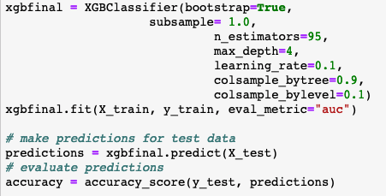
The Best Model
XGB is the winning model
The weighted average score was 85%

Slide 21
XGB Confusion matrix
Test data
20 TP: actual: HD predicted: HD | 3 FP (Type I Error): actual: NoHD predicted: HD (bad )
7 FN (type II error): actual: HD predicted: NoHD (bad ) | 31 TN: actual: NoHD predicted: NoHD

Slide 22
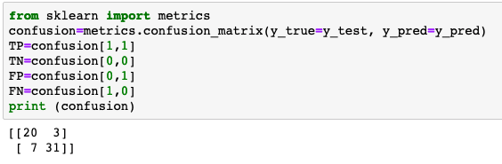
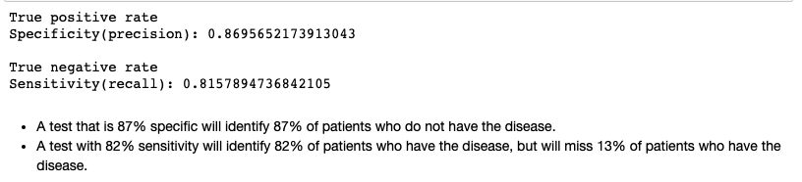
XGB model Evaluation
Recall and Precision

Slide 23
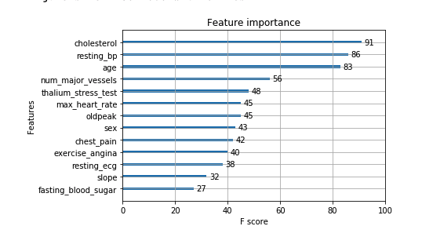
Feature Importance
The most significant features predicted for heart disease using the extreme gradient boost model was Cholesterol followed by blood pressure and age.

Slide 24
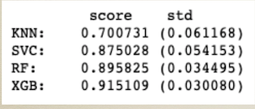
Summary
K-Nearest Neighbor was not a good fit for this data. KNN predicted too many false negative, type II errors. This might be due to the small size of the dataset.
Support Vector Machine — needs further reviewing
Random Forest did well due to the many random rows and columns selected which produces an accurate and diverse selection.The holdout did better than the training set.
XGBoost has more parameters to tune, like sub sample (helps with overfitting) and learning rate (reduces the size of the previous loss function gradient). It models on the errors in steps and trees are formed sequentially then combined to form a result. So unlike

Slide 25
Some short comings:
Maybe include new features for a better prediction such as family history, inflammation and blood sugar for diabetics. As the Reynolds Risk Score* for heart disease suggests.
Check whether any of the original 76 attributes would be beneficial to add back.
A larger dataset.
*http://www.reynoldsriskscore.org/

